Slide 1



Outage Dashbaord1
View in Power BI
Last data refresh:
11/2/2023 2:18:57 PM UTC
Downloaded at:
11/2/2023 2:19:39 PM UTC

Slide 2
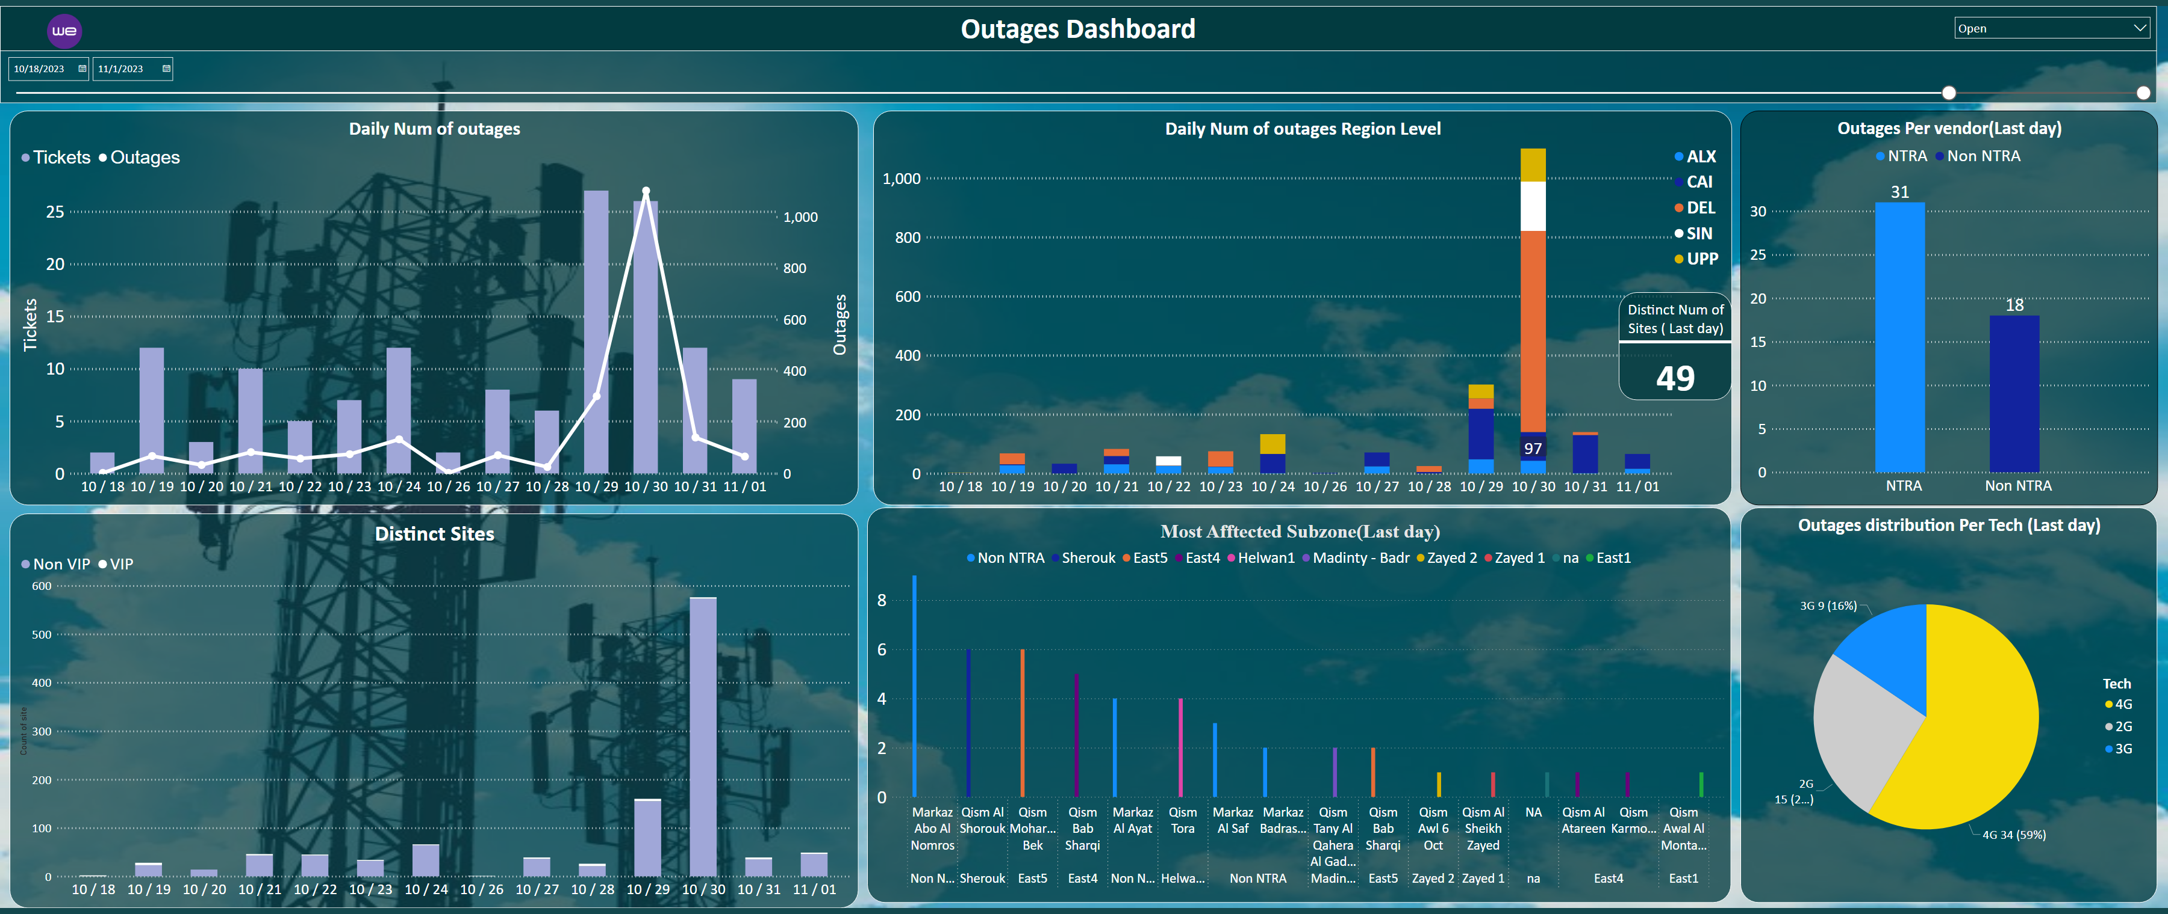
Outage Dashboard
Notes:
Daily Num of outages
No alt text provided
Daily Num of outages Region Level
No alt text provided
Distinct Sites
No alt text provided
Outages distribution Per Tech (Last day)
No alt text provided
Most Afftected Subzone(Last day)
No alt text provided
textbox
No alt text provided
image
No alt text provided
slicer
No alt text provided
slicer
No alt text provided
Outages Per vendor(Last day)
No alt text provided
Distinct Num of Sites ( Last day)
No alt text provided
slicer
No alt text provided

Slide 3
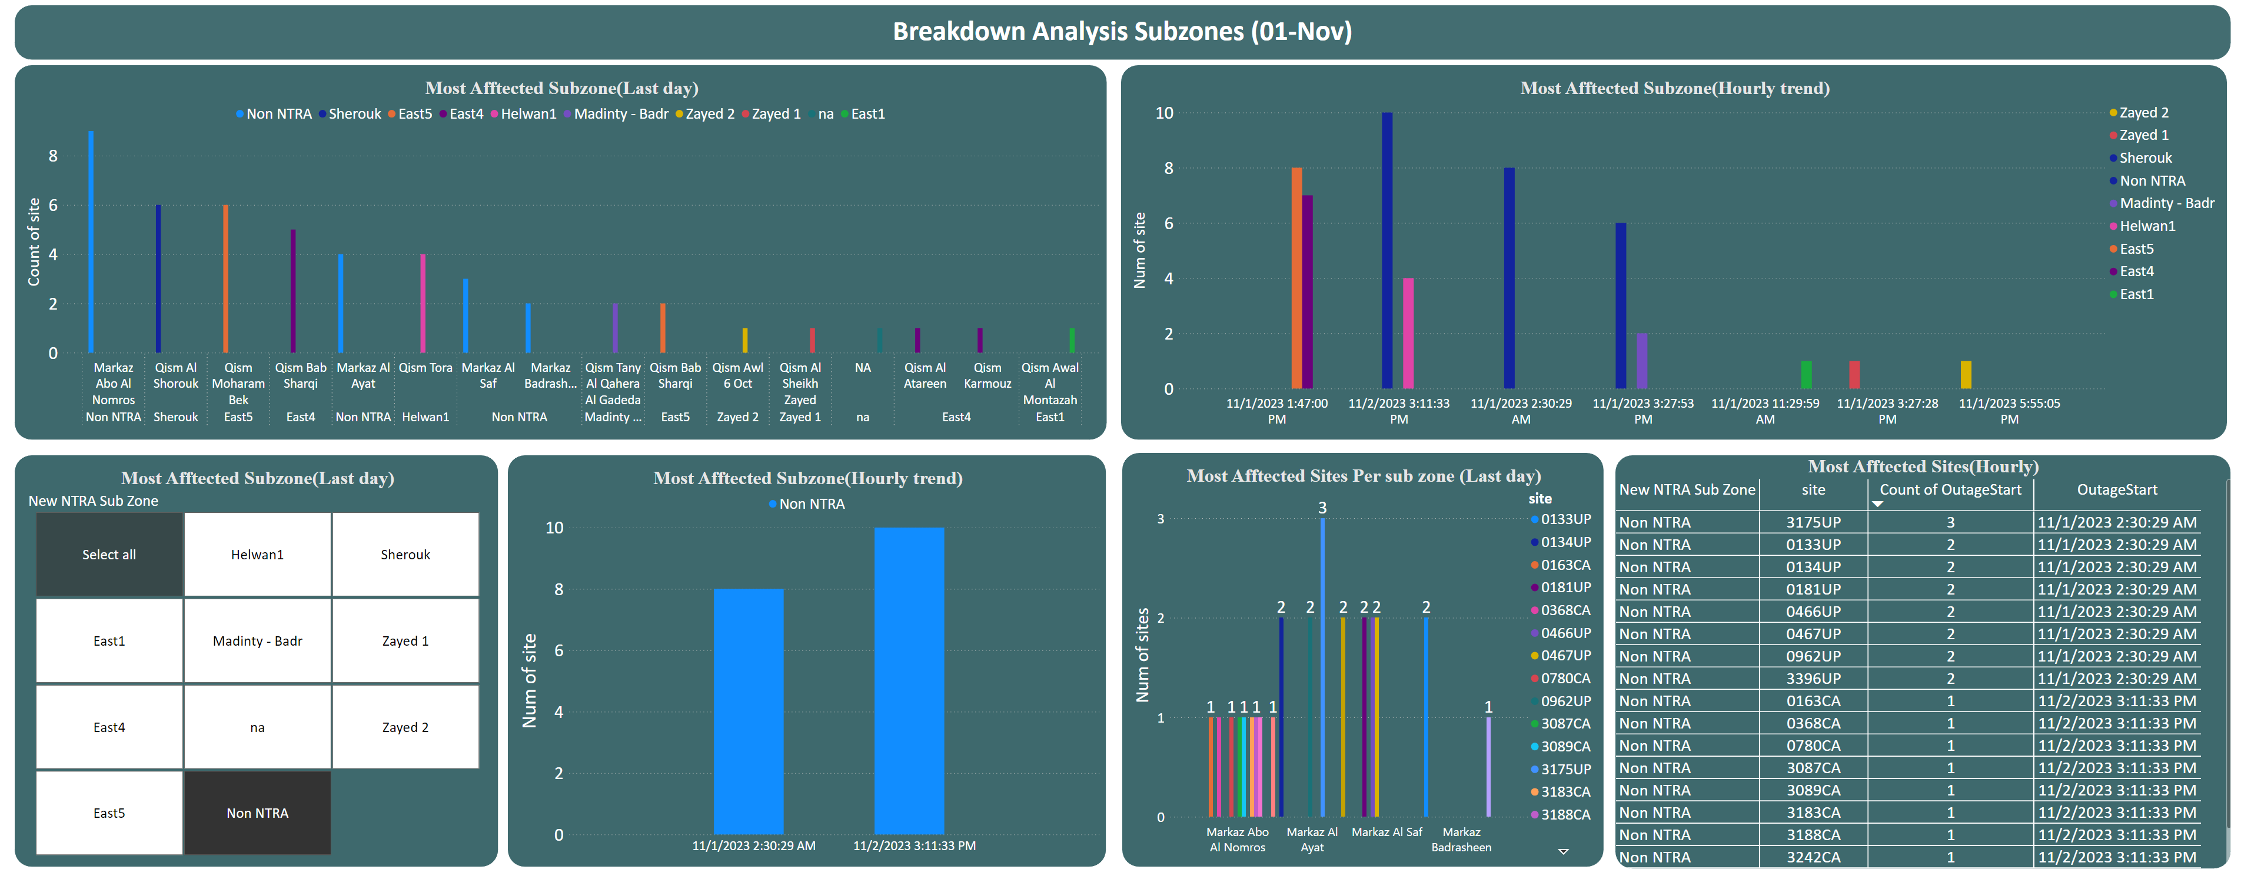
Breakdown Analysis Subzone
Notes:
Most Afftected Subzone(Last day)
No alt text provided
Most Afftected Sites Per sub zone (Last day)
No alt text provided
Most Afftected Subzone(Hourly trend)
No alt text provided
Most Afftected Subzone(Hourly trend)
No alt text provided
Most Afftected Subzone(Last day)
No alt text provided
textbox
No alt text provided
Most Afftected Sites(Hourly)
No alt text provided

Slide 4
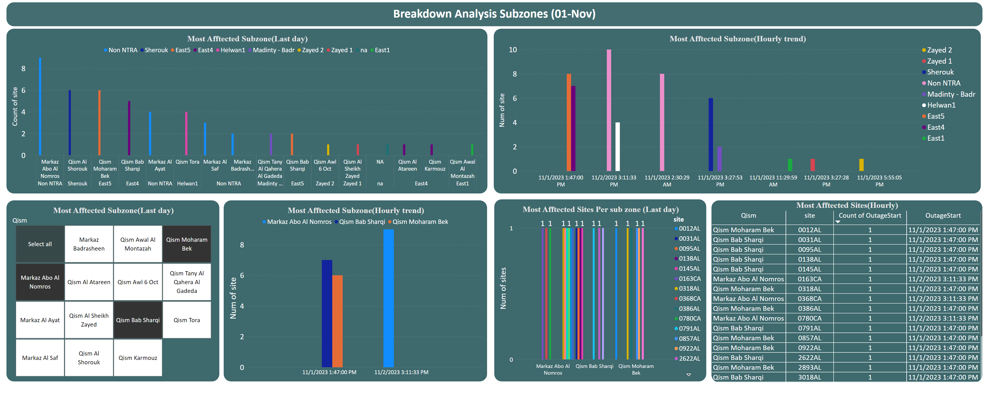
Breakdown Analysis Qism
Notes:
Most Afftected Subzone(Last day)
No alt text provided
Most Afftected Sites Per sub zone (Last day)
No alt text provided
Most Afftected Subzone(Hourly trend)
No alt text provided
Most Afftected Subzone(Hourly trend)
No alt text provided
Most Afftected Subzone(Last day)
No alt text provided
textbox
No alt text provided
Most Afftected Sites(Hourly)
No alt text provided

